Slide 1
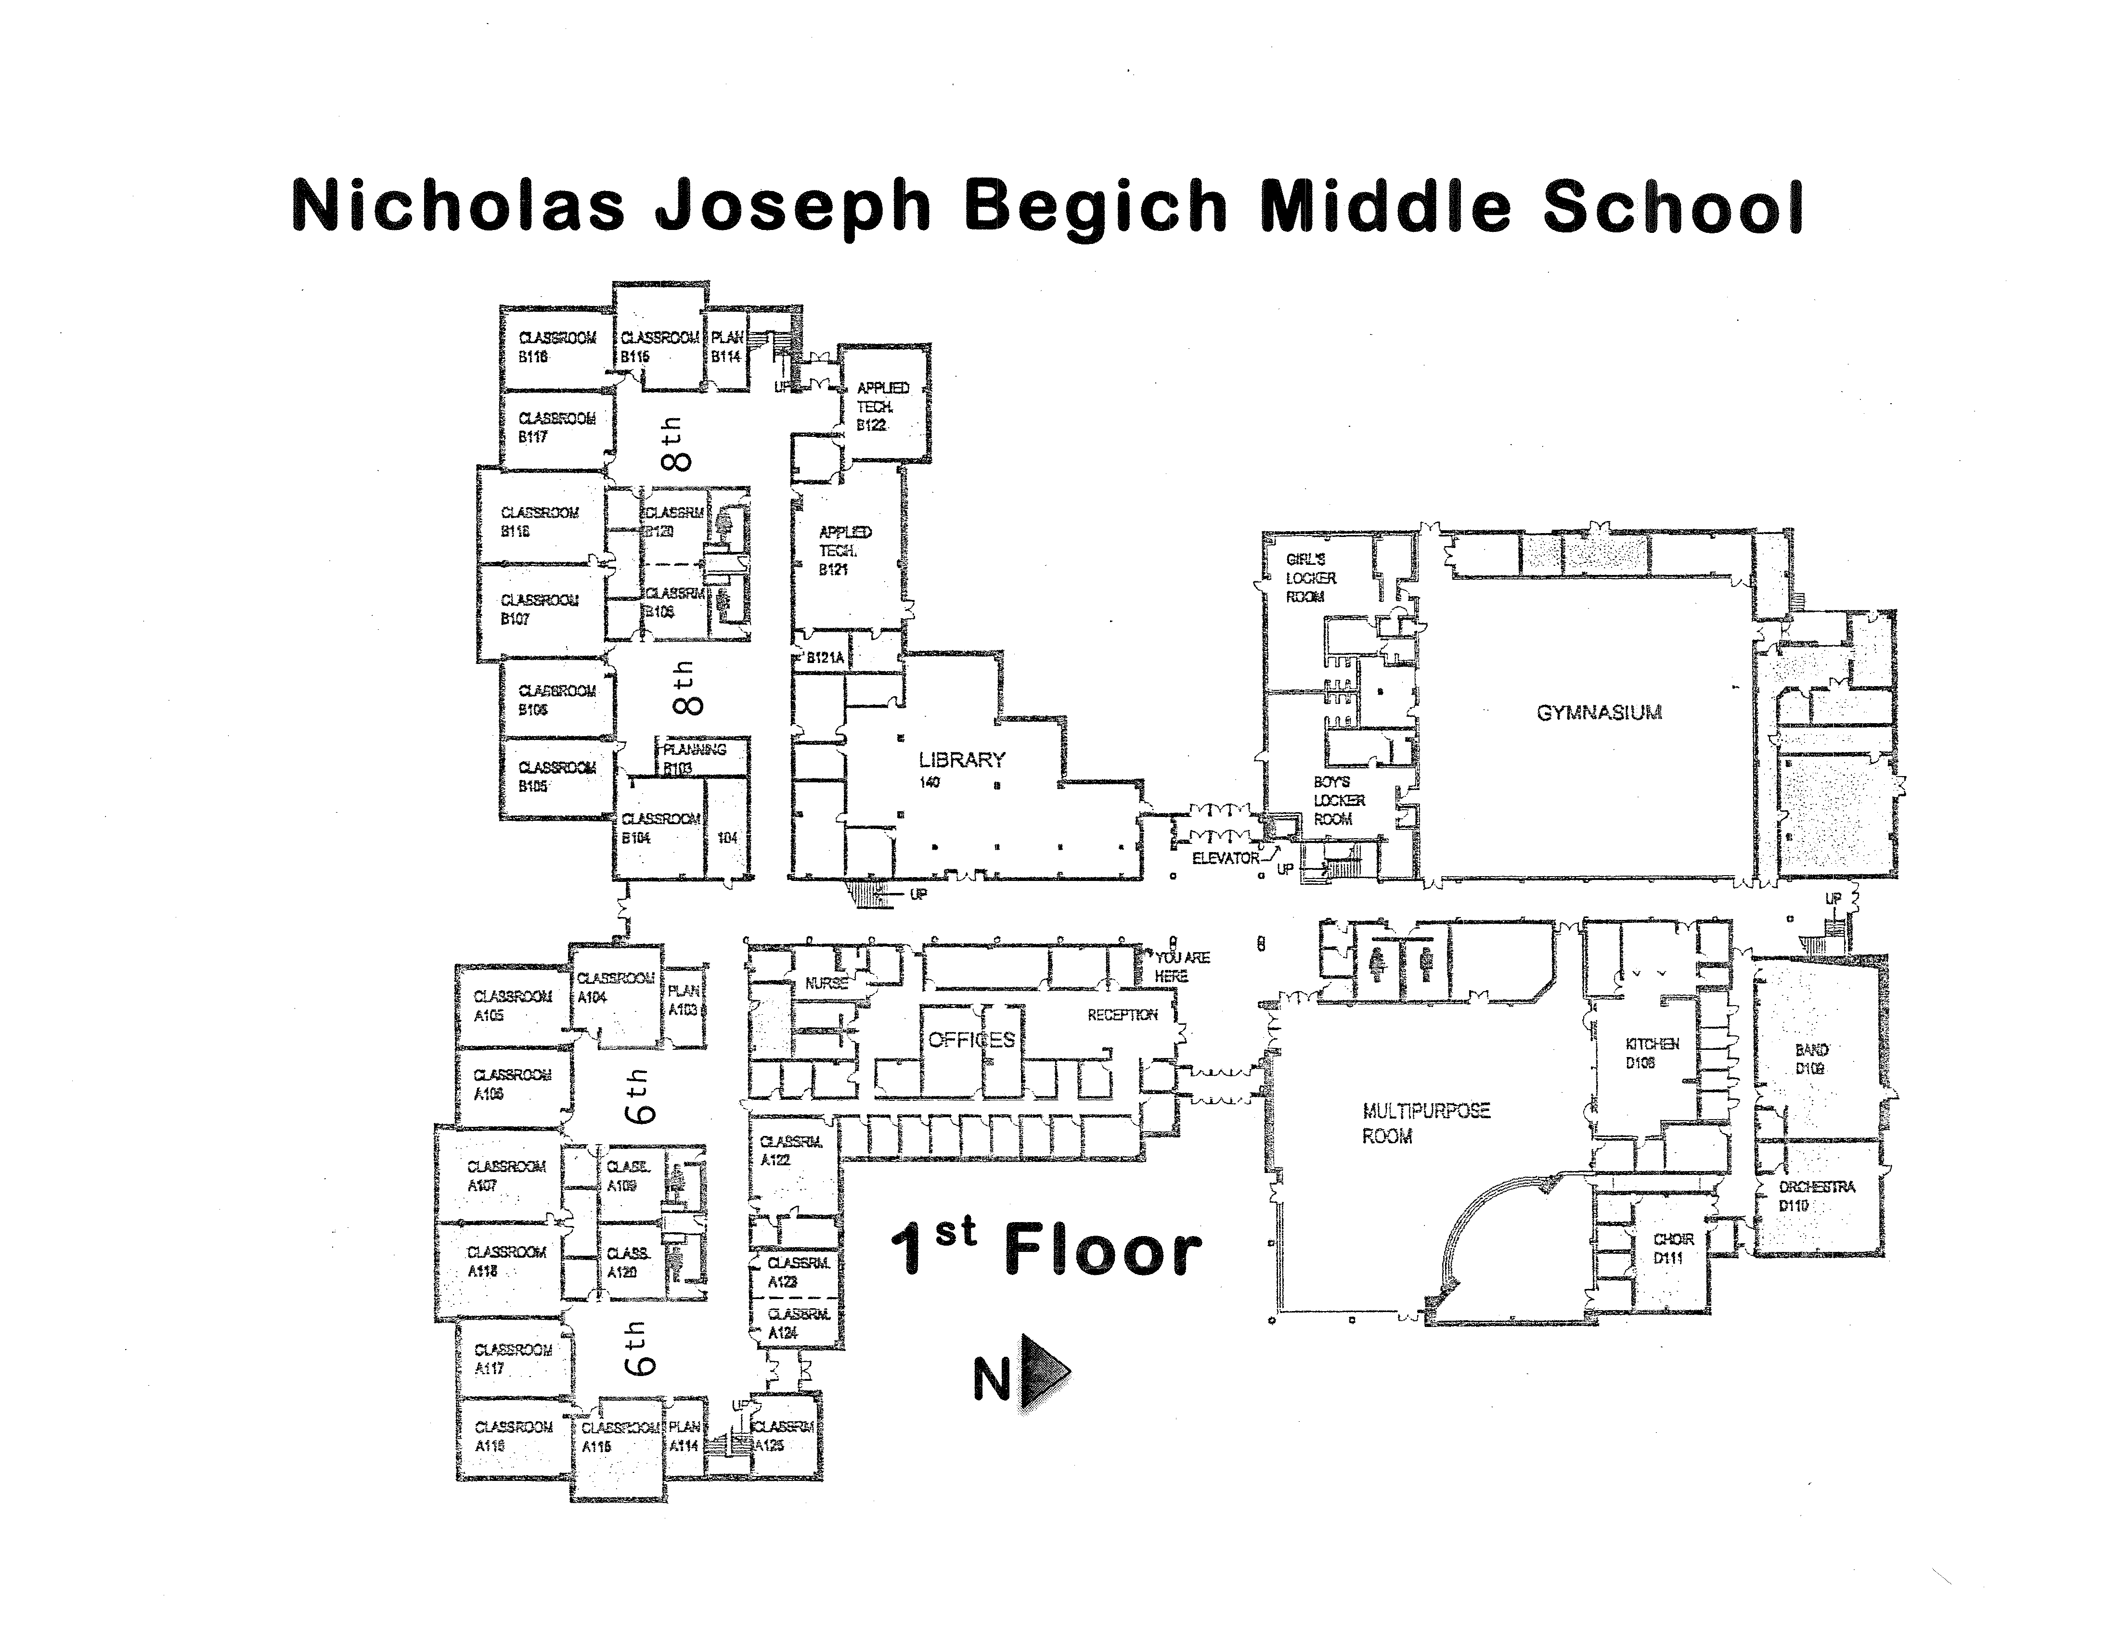
Foster
Ihedioha
Hveding
Saiki
Willis
Symmes
Kornely
Alaniva
Sperry
Krehlik
Hope-Bates
Wheeler
Powell
Hanley
Blewett
Lape
Head
Powell
Rosser
Grundon
Noel
Band
Krehlik
Azan
Kelly
Sarver
Oudean
Dion
Hoopes
Hernandez
Fan
Shuttleworth
Wall

Slide 2
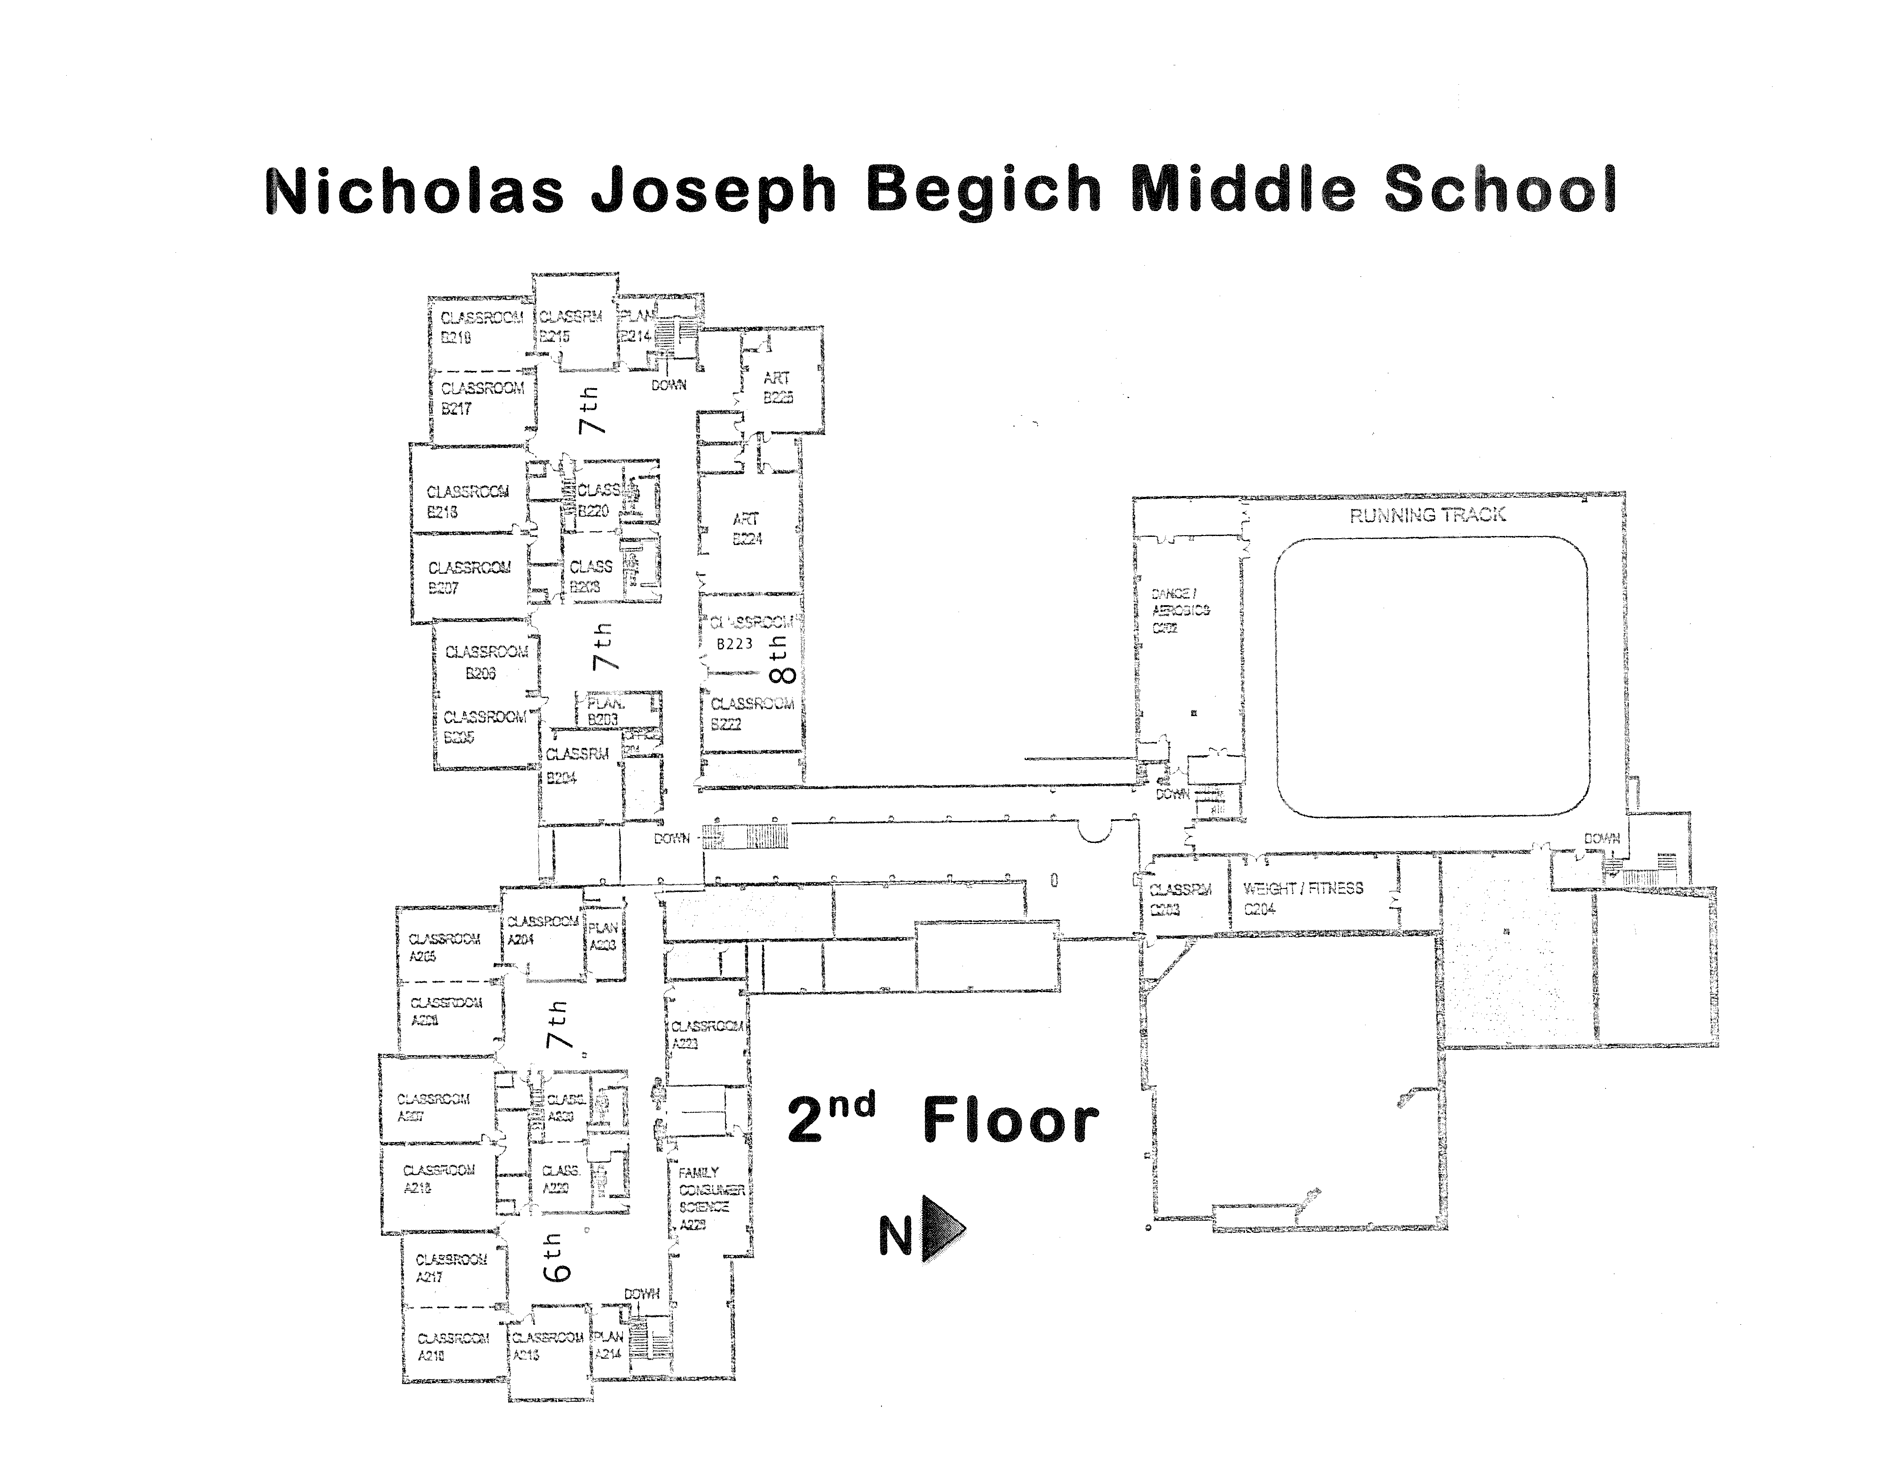
Wheeler
McFarland
Arturo
Smith
Science 7
McFarland
Souders
Sumanga
Hanks
Glass
Simacon
Graham
Bucayan
ISS
Barnett
Carroll
6th
Wilson
Folds
Sped Math 6/7
Clayton
O’Neil
Gumpf
Troup
Werts

